Slide 1
Network Security – 3413ICT
Mid-Semester Exam; Time: 9.00 – 10.30
Room: G06_3.18
Please write your Name & Student Number
… Any dishonest assignments will be dealt with under the rules applying in “The Process of Assessment, Grading and Dissemination of Results” and Statute 8.2 - Student Good Order as defined in the University Handbook.
Dishonest assignment includes:
• deliberate copying or attempting to copy the work of other students;
• use of or attempting to use information prohibited from use in that form of assessment;
• submitting the work or another as your own; or
• plagiarism (i.e. taking and using as your own the thoughts and writings of another with the intent to claim the work as your own).

Slide 2
3413ICT Network Security
Wireless Network Security
Dr V. Muthukkumarasamy
B.Sc.Eng (Hons) (Peradeniya), PhD (Cantab), MIEE, MIEEE

Slide 3
Previous Lecture…
Have studied…
Understand linear feedback shift register (LFSR)
Stream Ciphers, RC4
Advanced cipher – AES
Advanced hash functions

Slide 4
Today’Objectives
Importance of Wireless Networks
IEEE 802 Protocol Architecture
802.11 Wireless LAN Security
802.11i Robust Security Network
802.11i Phases of Operation
Wireless Transport Layer Security
Notes:
Now look at a simple form of encryption based on two concepts: the block cipher and the stream cipher.
Stream ciphers are based on a PRNG. The strength of the cipher depends on just how good the PRNG is. Good algorithms employ a lot of state and are highly secure. Stream ciphers must never re-use the same key and many mistakes occur because of this (Word/Excel encryption, WEP and so on).
With the block cipher method, the message is divided into blocks, i.e., 64 or 128 bit blocks, and then each block is transformed using the algorithm and key.

Slide 5
References
Computer Security Principles and Practice, (2nd Edition), W. Stallings & L. Brown,
Chapter 24

Slide 6
Wireless Technologies
Wi-Fi
IEEE 802.11a
IEEE 802.11b
IEEE 802.11g
IEEE 802.11n
WiMAX
Bluetooth
LTE

Slide 7
Wireless LANs (WLANs)
Use radio or infrared frequencies to transmit signals through the air (instead of cables)
Basic Categories
Use of Radio frequencies (focus of this lecture)
802.1x family of standards (aka, Wi-Fi)
Use of infrared frequencies (Optical transmission)
Wi-Fi grown in popularity
Eliminates cabling
Facilitates network access from a variety of locations
Facilitates for mobile workers (as in a hospital)
Used in 90 percent of companies

Slide 8
Wireless Standards
IEEE 802.11b
Standardization started after .11a, but finished before, more commonly used than .11a
IEEE 802.11a
First attempt to standardization of WLANs; more complicated than .11b
IEEE 802.11g, IEEE 802.11n
WiMAX
Bluetooth
Also an IEEE standard 802.15

Slide 9
Basic Components of WLANs
Network Interface Cards (NICs)
Many laptops come with WLAN cards built in
Also available as USB cards
About 100-300 feet max transmission range
Access Points (APs)
Used instead of hubs; act as a repeater
Must hear all computers in WLAN

Slide 10
Antennas used in WLANs
Omni directional antennas
Transmit in all directions simultaneously
Used on most WLANs
Dipole antenna (rubber duck)
Transmits in all direction (vertical, horizontal, up, down)
Directional antennas
Project signal only in one direction
Focused area; stronger signal; farther ranges
Most often used on inside of an exterior wall
To reduce the security issue
A potential problem with WLANs

Slide 11
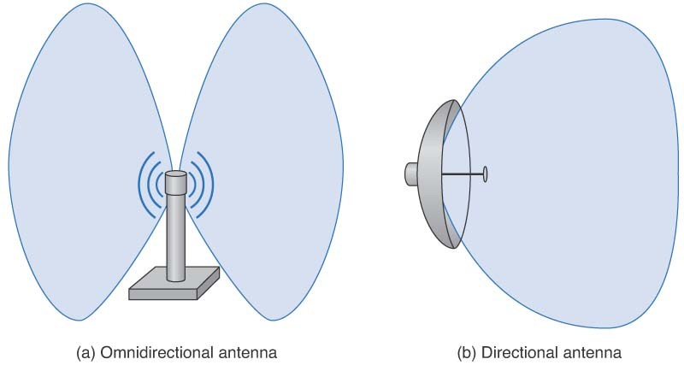
Types of Antennas

Slide 12
IEEE 802.11n
Ratified in 2009
Goal to provide high speed wireless networking
Uses both the 2.4 and 5 GHz frequency ranges
Date rates up to 600 Mbps are achieved
Backward compatible with a, b, and g
Average geometric range up to 400 meters

Slide 13
WiMAX
Stands for Worldwide Interoperability for Microwave Access
A family of IEEE 802.16 standards, including:
802.16d
802.16e
WiMAX offers a number of advantages over Wi-Fi:
greater throughput than 802,11a, b, or g
extended ranges – up to 50 km
more appropriate for use on MANs (metropolitan area networks) and WANs (wide area networks)

Slide 14
Bluetooth
A standard for Wireless Personal Area Networks (WPANs)
Provides networking in a very small area
Up to 10 meters (current generation)
Up to 100 meters (next generation)
Includes small and cheap devices designed to
Replace short distance cabling between devices: keyboards, mouse, handsets, etc
Provides a basic data rate of 1 Mbps

Slide 15
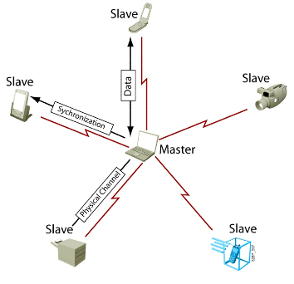
Bluetooth
A Bluetooth network is called as “Piconet”
It can consist of one master and seven slave devices
The “master” device controls other devices, “slaves”
Acts like an AP
Selects frequencies and controls access
All devices in a piconet share the same frequency range
Notes:
Bluetooth is a radio system (or radio frequency standard), which defines the concept of a wireless personal area network. A wireless personal area network is made up of devices, which are in close proximity to each other. The nominal link range for Bluetooth is up to 10 m at 0 dBm transmit strength, though it can function at ranges up to approximately 100 m with 20 dBm transmit strength. Bluetooth transmits on frequencies between 2.402 GHz and 2.480 GHz; this gives Bluetooth 79 channels on a frequency hopping scheme, which remain on any given frequency for approximately 400 ms. Bluetooth can reach speeds up to 720 kbps.There are three classes of Bluetooth products: Class 1 transmits at 100 mW, Class 2 transmits at 2.5 mW, and Class 3 uses a maximum transmit strength of 1 mW.

Slide 16
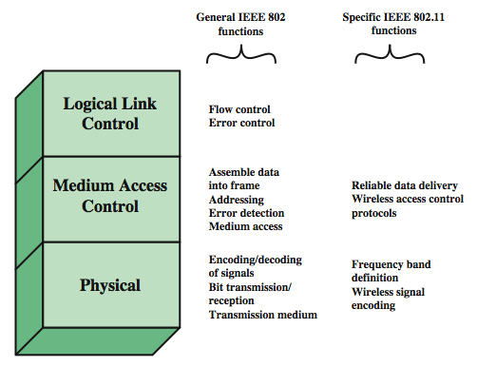
IEEE 802 Protocol Architecture
Notes:
Before proceeding, we need to briefly preview the IEEE 802 protocol architecture. IEEE 802.11 standards are defined within the structure of a layered set of protocols. This structure, used for all IEEE 802 standards, is illustrated in Stallings Figure 6.1.
The lowest layer of the IEEE 802 reference model is the physical layer, which includes such functions as encoding/decoding of signals and bit transmission/reception. In addition, the physical layer includes a specification of the transmission medium. In the case of IEEE 802.11, the physical layer also defines frequency bands and antenna characteristics.
Next is the media access control (MAC) layer, which controls access to the transmission medium to provide an orderly and efficient use of that capacity. The MAC layer receives data from a higher-layer protocol, typically the Logical Link Control (LLC) layer, in the form of a block of data known as the MAC service data unit (MSDU). The exact format of the MPDU differs somewhat for the various MAC protocols in use.
In most data link control protocols, the data link protocol entity is responsible not only for detecting errors using the CRC, but for recovering from those errors by retransmitting damaged frames. In the LAN protocol architecture, these two functions are split between the MAC and LLC layers. The MAC layer is responsible for detecting errors and discarding any frames that contain errors. The LLC layer optionally keeps track of which frames have been successfully received and retransmits unsuccessful frames.

Slide 17
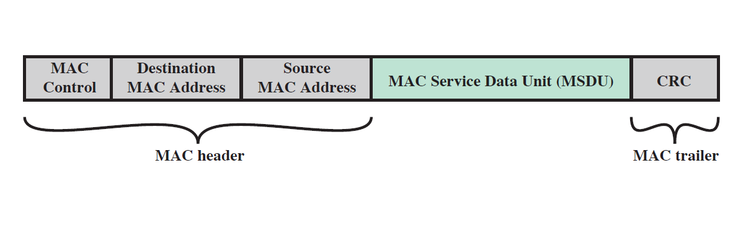
MPDU Format
On transmission controlled by the MAC layer, data is assembled as MAC protocol data unit (MPDU)
MPDU has the following fields:
Notes:
Now look at a simple form of encryption based on two concepts: the block cipher and the stream cipher.
Stream ciphers are based on a PRNG. The strength of the cipher depends on just how good the PRNG is. Good algorithms employ a lot of state and are highly secure. Stream ciphers must never re-use the same key and many mistakes occur because of this (Word/Excel encryption, WEP and so on).
With the block cipher method, the message is divided into blocks, i.e., 64 or 128 bit blocks, and then each block is transformed using the algorithm and key.

Slide 18
802.11 Wireless LAN Security
Security issue: wireless traffic can be monitored by any radio in range, not necessarily physically connected
Original 802.11 specification had security features
Wired Equivalent Privacy (WEP) algorithm
but found it contained major weaknesses
802.11i includes capabilities to address WLAN security issues
Wi-Fi Protected Access (WPA)
WPA2 (also called Robust Security Network (RSN) )
Notes:
The differences between wired and wireless LANs (in that wireless traffic can be monitored by any radio in range, and need not be physically connected) suggest the increased need for robust security services and mechanisms for wireless LANs. The original 802.11 specification included a set of security features for privacy and authentication that were quite weak. For privacy, 802.11 defined the Wired Equivalent Privacy (WEP) algorithm. The privacy portion of the 802.11 standard contained major weaknesses. Subsequent to the development of WEP, the 802.11i task group has developed a set of capabilities to address the WLAN security issues. In order to accelerate the introduction of strong security into WLANs, the Wi-Fi Alliance promulgated Wi-Fi Protected Access (WPA) as a Wi-Fi standard. WPA is a set of security mechanisms that eliminates most 802.11 security issues and was based on the current state of the 802.11i standard. The final form of the 802.11i standard is referred to as Robust Security Network (RSN). The Wi-Fi Alliance certifies vendors in compliance with the full 802.11i specification under the WPA 2 program.

Slide 19
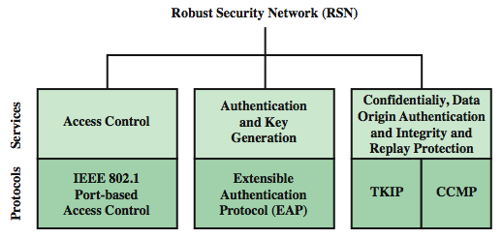
802.11i RSN Services & Protocols
Notes:
The 802.11i RSN security specification defines the following services:
• Authentication: A protocol is used to define an exchange between a user and an AS that provides mutual authentication and generates temporary keys to be used between the client and the AP over the wireless link.
• Access control: This function enforces the use of the authentication function, routes the messages properly, and facilitates key exchange. It can work with a variety of authentication protocols.
• Privacy with message integrity: MAC-level data (e.g., an LLC PDU) are encrypted, along with a message integrity code that ensures that the data have not been altered.
Stallings Figure 17.4a indicates the security protocols used to support these services.

Slide 20
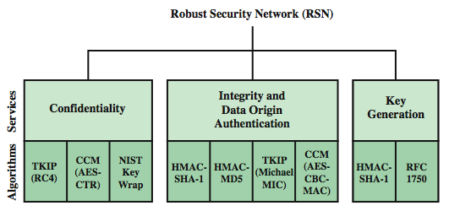
802.11i RSN Crypto. Algorithms
TKIP: Temporal Key Integrity Protocol
CCM: Counter Mode with Cipher Block Chaining Message Authentication Code
HMAC: Hash-based Message Authentication Code
Notes:
Stallings Figure 17.4b lists the cryptographic algorithms used for the 802.11i RSN security services.

Slide 21
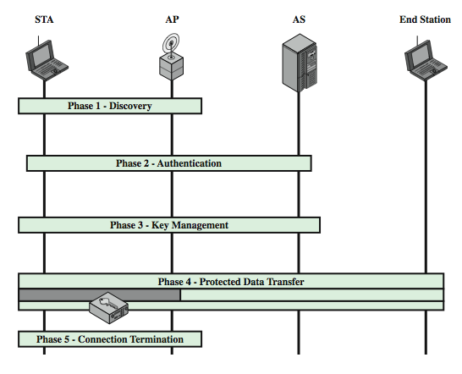
802.11i Phases of Operation
Notes:
The operation of an IEEE 802.11i RSN can be broken down into five distinct phases of operation, as shown in Stallings Figure 17.5. One new component is the authentication server (AS). The five phase are:
• Discovery: An AP uses messages called Beacons and Probe Responses to advertise its IEEE 802.11i security policy. The STA uses these to identify an AP for a WLAN with which it wishes to communicate. The STA associates with the AP, which it uses to select the cipher suite and authentication mechanism when the Beacons and Probe Responses present a choice.
• Authentication: During this phase, the STA and AS prove their identities to each other. The AP blocks non-authentication traffic between the STA and AS until the authentication transaction is successful. The AP does not participate in the authentication transaction other than forwarding traffic between the STA and AS. • Key generation and distribution: The AP and the STA perform several operations that cause cryptographic keys to be generated and placed on the AP and the STA. Frames are exchanged between the AP and STA only
• Protected data transfer: Frames are exchanged between the STA and the end station through the AP. As denoted by the shading and the encryption module icon, secure data transfer occurs between the STA and the AP only; security is not provided end-to-end.
• Connection termination: The AP and STA exchange frames. During this phase, the secure connection is torn down and the connection is restored to the original state.

Slide 22
802.11i Phases
Discovery
AP advertises its IEEE 802.11i security policy
STA identifies an AP which it wishes to communicates
STA associates with the AP, selects cipher suite and authentication mechanism
Authentication
STA and AS prove their identities to each other
AP does not participate in the authentication transaction, other than forwarding traffic between STA and AS
Notes:
The differences between wired and wireless LANs (in that wireless traffic can be monitored by any radio in range, and need not be physically connected) suggest the increased need for robust security services and mechanisms for wireless LANs. The original 802.11 specification included a set of security features for privacy and authentication that were quite weak. For privacy, 802.11 defined the Wired Equivalent Privacy (WEP) algorithm. The privacy portion of the 802.11 standard contained major weaknesses. Subsequent to the development of WEP, the 802.11i task group has developed a set of capabilities to address the WLAN security issues. In order to accelerate the introduction of strong security into WLANs, the Wi-Fi Alliance promulgated Wi-Fi Protected Access (WPA) as a Wi-Fi standard. WPA is a set of security mechanisms that eliminates most 802.11 security issues and was based on the current state of the 802.11i standard. The final form of the 802.11i standard is referred to as Robust Security Network (RSN). The Wi-Fi Alliance certifies vendors in compliance with the full 802.11i specification under the WPA 2 program.

Slide 23
802.11i Phases
Key generation and distribution
AP and STA perform operations that cause crypto. keys to be generated and placed on AP and STA
Protected data transfer
Frames are exchanged between the STA & end station through AP
Secure data transfer occurs between STA and AP only (security is not provided end-to-end)
Connection termination
Secure connection is torn down and the connection is restored to the original state
Notes:
The differences between wired and wireless LANs (in that wireless traffic can be monitored by any radio in range, and need not be physically connected) suggest the increased need for robust security services and mechanisms for wireless LANs. The original 802.11 specification included a set of security features for privacy and authentication that were quite weak. For privacy, 802.11 defined the Wired Equivalent Privacy (WEP) algorithm. The privacy portion of the 802.11 standard contained major weaknesses. Subsequent to the development of WEP, the 802.11i task group has developed a set of capabilities to address the WLAN security issues. In order to accelerate the introduction of strong security into WLANs, the Wi-Fi Alliance promulgated Wi-Fi Protected Access (WPA) as a Wi-Fi standard. WPA is a set of security mechanisms that eliminates most 802.11 security issues and was based on the current state of the 802.11i standard. The final form of the 802.11i standard is referred to as Robust Security Network (RSN). The Wi-Fi Alliance certifies vendors in compliance with the full 802.11i specification under the WPA 2 program.

Slide 24
Discovery Phase
The discovery phase consists three exchanges:
Network and security capability discovery:
STA discover the existence of a network
AP either periodically broadcasts security capabilities, or
responds to a STA’s Probe Request
Open system authentication:
STA and AP exchange identities (no security yet at this step)
Association:
Agree on a set of security parameters
Notes:
The differences between wired and wireless LANs (in that wireless traffic can be monitored by any radio in range, and need not be physically connected) suggest the increased need for robust security services and mechanisms for wireless LANs. The original 802.11 specification included a set of security features for privacy and authentication that were quite weak. For privacy, 802.11 defined the Wired Equivalent Privacy (WEP) algorithm. The privacy portion of the 802.11 standard contained major weaknesses. Subsequent to the development of WEP, the 802.11i task group has developed a set of capabilities to address the WLAN security issues. In order to accelerate the introduction of strong security into WLANs, the Wi-Fi Alliance promulgated Wi-Fi Protected Access (WPA) as a Wi-Fi standard. WPA is a set of security mechanisms that eliminates most 802.11 security issues and was based on the current state of the 802.11i standard. The final form of the 802.11i standard is referred to as Robust Security Network (RSN). The Wi-Fi Alliance certifies vendors in compliance with the full 802.11i specification under the WPA 2 program.

Slide 25
Authentication Phase
The authentication
Uses a standard for port-based network access control, called IEEE 802.1X
which provides access control mechanism to devices wishing to attach to a LAN or WLAN
It uses Extensible Authentication Protocol (EAP)
802.1X authentication involves three parties: supplicant (i.e., wireless station), authenticator (i.e., AP), authentication server (i.e., AS)
Notes:
The differences between wired and wireless LANs (in that wireless traffic can be monitored by any radio in range, and need not be physically connected) suggest the increased need for robust security services and mechanisms for wireless LANs. The original 802.11 specification included a set of security features for privacy and authentication that were quite weak. For privacy, 802.11 defined the Wired Equivalent Privacy (WEP) algorithm. The privacy portion of the 802.11 standard contained major weaknesses. Subsequent to the development of WEP, the 802.11i task group has developed a set of capabilities to address the WLAN security issues. In order to accelerate the introduction of strong security into WLANs, the Wi-Fi Alliance promulgated Wi-Fi Protected Access (WPA) as a Wi-Fi standard. WPA is a set of security mechanisms that eliminates most 802.11 security issues and was based on the current state of the 802.11i standard. The final form of the 802.11i standard is referred to as Robust Security Network (RSN). The Wi-Fi Alliance certifies vendors in compliance with the full 802.11i specification under the WPA 2 program.

Slide 26
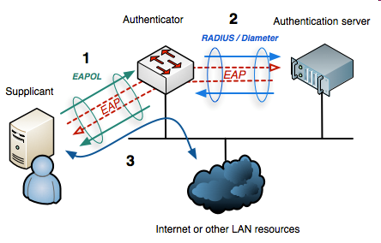
Authentication Phase
The authenticator acts like a security guard to a protected network
The supplicant is not allowed access to the protected side of the network until the supplicant’s identity has been validated and authorized
The supplicant provides credentials (user name / password or certificate), to the authenticator, and the authenticator forwards them AS for verification
26
Notes:
The differences between wired and wireless LANs (in that wireless traffic can be monitored by any radio in range, and need not be physically connected) suggest the increased need for robust security services and mechanisms for wireless LANs. The original 802.11 specification included a set of security features for privacy and authentication that were quite weak. For privacy, 802.11 defined the Wired Equivalent Privacy (WEP) algorithm. The privacy portion of the 802.11 standard contained major weaknesses. Subsequent to the development of WEP, the 802.11i task group has developed a set of capabilities to address the WLAN security issues. In order to accelerate the introduction of strong security into WLANs, the Wi-Fi Alliance promulgated Wi-Fi Protected Access (WPA) as a Wi-Fi standard. WPA is a set of security mechanisms that eliminates most 802.11 security issues and was based on the current state of the 802.11i standard. The final form of the 802.11i standard is referred to as Robust Security Network (RSN). The Wi-Fi Alliance certifies vendors in compliance with the full 802.11i specification under the WPA 2 program.
26

Slide 27
Protected Data Transfer Phase
It has two schemes for protecting data: TKIP & CCMP
Temporal Key Integrity Protocol (TKIP)
It is designed to improve the WEP, by only s/w changes
Provides integrity, by adding a 64-bit message integrity code (MIC), generated by an algorithm called Michael
Confidentiality, by encrypting MPDU plus MIC value using RC4
Counter Mode-CBC MAC Protocol (CCMP)
uses the cipher block chaining message authentication code (CBC-MAC) for integrity
uses the CRT block cipher mode with AES, for confidentiality
Notes:
IEEE 802.11i defines two schemes for protecting 802.11 MPDU data message integrity and confidentiality: the Temporal Key Integrity Protocol (TKIP), and the Counter Mode-CBC MAC Protocol (CCMP).
TKIP is designed to require only software changes to devices that are implemented with the older wireless LAN security approach called Wired Equivalent Privacy (WEP). TKIP adds a 64-bit message integrity code (MIC), generated by an algorithm, called Michael, to the 802.11 MAC frame after the data field. TKIP provides data confidentiality by encrypting the MPDU plus MIC value using RC4.
CCMP is intended for newer IEEE 802.11 devices that are equipped with the hardware to support this scheme. CCMP uses the cipher block chaining message authentication code (CBC-MAC), described in Chapter 12, to provide message integrity. CCMP uses the CRT block cipher mode of operation, described in Chapter 6, with AES for encryption. The same 128-bit AES key is used for both integrity and confidentiality. The scheme uses a 48-bit packet number to construct a nonce to prevent replay attacks.

Slide 28
802.11i Pseudorandom Function
A pseudorandom function (PRF) is used in IEEE 802.11i
The PRF is built on the use of HMAC-SHA-1
takes a key of length 160 bits, produces a 160-bit hash based message authentication code
For the PRF, the change of a single bit of the input produces a new hash value with no apparent connect to the preceding hash value
Notes:
IEEE 802.11i defines two schemes for protecting 802.11 MPDU data message integrity and confidentiality: the Temporal Key Integrity Protocol (TKIP), and the Counter Mode-CBC MAC Protocol (CCMP).
TKIP is designed to require only software changes to devices that are implemented with the older wireless LAN security approach called Wired Equivalent Privacy (WEP). TKIP adds a 64-bit message integrity code (MIC), generated by an algorithm, called Michael, to the 802.11 MAC frame after the data field. TKIP provides data confidentiality by encrypting the MPDU plus MIC value using RC4.
CCMP is intended for newer IEEE 802.11 devices that are equipped with the hardware to support this scheme. CCMP uses the cipher block chaining message authentication code (CBC-MAC), described in Chapter 12, to provide message integrity. CCMP uses the CRT block cipher mode of operation, described in Chapter 6, with AES for encryption. The same 128-bit AES key is used for both integrity and confidentiality. The scheme uses a 48-bit packet number to construct a nonce to prevent replay attacks.

Slide 29
802.11i Pseudorandom Function
The 802.11i PRF takes four parameters as input and produces the desired number of random bits (can be more than 160 bits):
K: a secret key, A: a string specific to the application
B: data specific to each case, Len: desired number of bits
It also takes (as input) a byte with value 0, and a counter i, which is initialized to 0
If more than 160 bits are required, the PRF is run again with the same inputs, except the counter is increased each time
Notes:
IEEE 802.11i defines two schemes for protecting 802.11 MPDU data message integrity and confidentiality: the Temporal Key Integrity Protocol (TKIP), and the Counter Mode-CBC MAC Protocol (CCMP).
TKIP is designed to require only software changes to devices that are implemented with the older wireless LAN security approach called Wired Equivalent Privacy (WEP). TKIP adds a 64-bit message integrity code (MIC), generated by an algorithm, called Michael, to the 802.11 MAC frame after the data field. TKIP provides data confidentiality by encrypting the MPDU plus MIC value using RC4.
CCMP is intended for newer IEEE 802.11 devices that are equipped with the hardware to support this scheme. CCMP uses the cipher block chaining message authentication code (CBC-MAC), described in Chapter 12, to provide message integrity. CCMP uses the CRT block cipher mode of operation, described in Chapter 6, with AES for encryption. The same 128-bit AES key is used for both integrity and confidentiality. The scheme uses a 48-bit packet number to construct a nonce to prevent replay attacks.

Slide 30
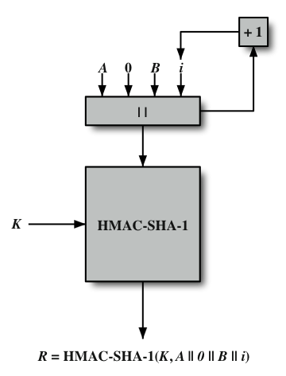
IEEE 802.11i Pseudorandom Function
Notes:
At a number of places in the IEEE 802.11i scheme, a pseudorandom function (PRF) is used. For example, it is used to generate nonces, to expand pairwise keys, and to generate the GTK. The PRF is built on the use of HMAC-SHA-1 to generate a pseudorandom bit stream. Recall that HMAC-SHA-1 takes a message (block of data) and a key of length at least 160 bits and produces a 160-bit hash value. SHA-1 has the property that the change of a single bit of the input produces a new hash value with no apparent connection to the preceding hash value. This property is the basis for pseudorandom number generation. The IEEE 802.11i PRF takes four parameters (a secret key K, an application specific text string A, some data specific to each case B, and the desired number of pseudorandom bits Len) as input, and produces the desired number of random bits.
Stallings Figure 17.10 illustrates the function PRF(K, A, B, Len). The parameter K serves as the key input to HMAC. The message input consists of four items concatenated together: the parameter A, a byte with value 0, the parameter B, and a counter i. The counter is initialized to 0. The HMAC algorithm is run once, producing a 160-bit hash value. If more bits are required, HMAC is run again with the same inputs, except that i is incremented each time, until the necessary number of bits is generated.

Slide 31
Wireless Transport Layer Security (WTLS)
It provides security services between mobile device (client) and WAP gateway
provides data integrity, privacy, authentication, denial-of-service protection
It is based on TLS (Transport Layer Security)
more efficient with fewer message exchanges
use WTLS between the client and gateway
use TLS between gateway and target server
WAP gateway translates WTLS / TLS
Notes:
Wireless Transport Layer Security (WTLS) provides security services between the mobile device (client) and the WAP gateway. WTLS provides: data integrity, privacy, authentication, and denial-of-service protection. WTLS is based on the industry-standard Transport Layer Security (TLS) Protocol3, which is a refinement of the secure sockets layer (SSL) protocol. TLS is the standard security protocol used between Web browsers and Web servers. WTLS is more efficient that TLS, requiring fewer message exchanges. To provide end-to-end security, WTLS is used between the client and the gateway, and TLS is used between the gateway and the target server (see Stallings Figure 6.14 on earlier slide). WAP systems translate between WTLS and TLS within the WAP gateway. Thus, the gateway is a point of vulnerability and must be given a high level of security from external attacks.

Slide 32
WTLS Sessions and Connections
Secure connection
a transport providing a suitable type of service
connections are transient
every connection is associated with one session
Secure session
an association between a client and a server
created by Handshake Protocol
define set of cryptographic security parameters
shared among multiple connections
Notes:
Two important WTLS concepts are:
• Secure connection: A connection is a transport (in the OSI layering model definition) that provides a suitable type of service. For SSL, such connections are peer-to-peer relationships. The connections are transient. Every connection is associated with one session.
• Secure session: An SSL session is an association between a client and a server. Sessions are created by the Handshake Protocol. Sessions define a set of cryptographic security parameters, which can be shared among multiple connections. Sessions are used to avoid the expensive negotiation of new security parameters for each connection.
Between any pair of parties (applications like HTTP on client and server), there may be multiple secure connections. In theory, there may also be multiple simultaneous sessions between parties, but this feature is not used in practice.
There are a number of states associated with each session (see text for details). Once a session is established, there is a current operating state for both read and write (eg. receive and send). In addition, during the Handshake Protocol, pending read & write states are created. Upon successful conclusion of the Handshake Protocol, the pending states become the current states.
The connection state (see text) is the operating environment of the record protocol. It includes all parameters that are needed for the cryptographic operations (encryption/decryption and MAC calculation/verification).

Slide 33
WTLS Session
A WTLS session state is defined by:
Session identifier: an arbitrary byte sequence chosen by the server
Protocol version: WTLS protocol version number
Peer certificate: certificate of the peer
Compression method: algorithm used to compress data
Cipher spec: specifies encryption algorithms (RC5, DES, etc) and hash algorithms (SHA-1, MD5, etc)
Master secret: 20-byte secret shared between the client and server
Sequence number: sequence numbering scheme used in this connection
Key refresh: Defines how often some values (crypto. Key, IV, etc) are re-calculated
etc
Notes:
Two important WTLS concepts are:
• Secure connection: A connection is a transport (in the OSI layering model definition) that provides a suitable type of service. For SSL, such connections are peer-to-peer relationships. The connections are transient. Every connection is associated with one session.
• Secure session: An SSL session is an association between a client and a server. Sessions are created by the Handshake Protocol. Sessions define a set of cryptographic security parameters, which can be shared among multiple connections. Sessions are used to avoid the expensive negotiation of new security parameters for each connection.
Between any pair of parties (applications like HTTP on client and server), there may be multiple secure connections. In theory, there may also be multiple simultaneous sessions between parties, but this feature is not used in practice.
There are a number of states associated with each session (see text for details). Once a session is established, there is a current operating state for both read and write (eg. receive and send). In addition, during the Handshake Protocol, pending read & write states are created. Upon successful conclusion of the Handshake Protocol, the pending states become the current states.
The connection state (see text) is the operating environment of the record protocol. It includes all parameters that are needed for the cryptographic operations (encryption/decryption and MAC calculation/verification).

Slide 34
WTLS Connection
A WTLS connection state is defined by:
Connection end: whether this entity is considered a client or server
Bulk cipher algorithm: include key size, etc.
MAC algorithm: key size of the MAC and hash algorithms
Compression algorithm: all information the algorithm requires to do compression
Master secret: 20-byte secret shared between the client and server
Client random: A 16-byte value provided by the client
Server random: A 16-byte value provided by the server
Sequence number mode: used to communicate sequence numbers
Key refresh: Defines how often some connection parameters (crypto. Key, IV, etc) are re-calculated
Notes:
Two important WTLS concepts are:
• Secure connection: A connection is a transport (in the OSI layering model definition) that provides a suitable type of service. For SSL, such connections are peer-to-peer relationships. The connections are transient. Every connection is associated with one session.
• Secure session: An SSL session is an association between a client and a server. Sessions are created by the Handshake Protocol. Sessions define a set of cryptographic security parameters, which can be shared among multiple connections. Sessions are used to avoid the expensive negotiation of new security parameters for each connection.
Between any pair of parties (applications like HTTP on client and server), there may be multiple secure connections. In theory, there may also be multiple simultaneous sessions between parties, but this feature is not used in practice.
There are a number of states associated with each session (see text for details). Once a session is established, there is a current operating state for both read and write (eg. receive and send). In addition, during the Handshake Protocol, pending read & write states are created. Upon successful conclusion of the Handshake Protocol, the pending states become the current states.
The connection state (see text) is the operating environment of the record protocol. It includes all parameters that are needed for the cryptographic operations (encryption/decryption and MAC calculation/verification).

Slide 35
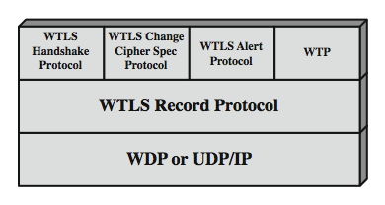
WTLS Protocol Architecture
Notes:
WTLS is not a single protocol but rather two layers of protocols, as illustrated in Stallings Figure 6.15. The WTLS Record Protocol provides basic security services to various higher-layer protocols. In particular, the Hypertext Transfer Protocol (HTTP), which provides the transfer service for Web client/server interaction, can operate on top of WTLS. Three higher-layer protocols are defined as part of WTLS: the Handshake Protocol, The Change Cipher Spec Protocol, and the Alert Protocol. These WTLS-specific protocols are used in the management of WTLS exchanges and are examined next.

Slide 36
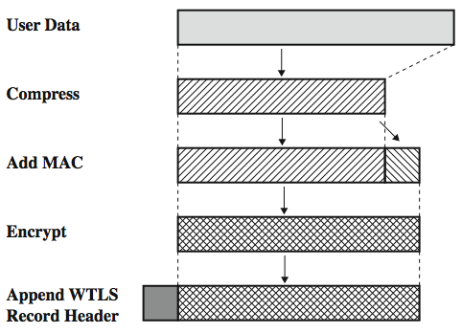
WTLS Record Protocol
Notes:
The WTLS Record Protocol takes user data from the next higher layer (WTP, WTLS handshake protocol, WTLS alert protocol, WTLS change cipher spec protocol) and encapsulates these data in a PDU. The following steps occur (Figure 6.16):
The payload is compressed using a lossless compression algorithm.
A message authentication code (MAC) is computed over the compressed data, using HMAC. One of several hash algorithms can be used with HMAC, including MD-5 and SHA-1. The length of the hash code is 0, 5, or 10 bytes. The MAC is added after the compressed data.
The compressed message plus the MAC code are encrypted using a symmetric encryption algorithm. The allowable encryption algorithms are DES, triple DES, RC5, and IDEA.
The Record Protocol prepends a header to the encrypted payload.
The Record Protocol header the fields as shown in Stallings Figure 17.17, and described in the text.

Slide 37
WTLS Higher-Layer Protocols
Change Cipher Spec Protocol
simplest, to make pending state current
Alert Protocol
used to convey WTLS-related alerts to peer
has severity: warning, critical, or fatal
and specific alert type
Handshake Protocol
allow server & client to mutually authenticate
negotiate encryption & MAC algs & keys
Notes:
The Change Cipher Spec Protocol is one of the three WTLS-specific protocols that use the WTLS Record Protocol, and it is the simplest. This protocol consists of a single message, which consists of a single byte with the value 1. The sole purpose of this message is to cause the pending state to be copied into the current state, which updates the cipher suite to be used on this connection.
The Alert Protocol is used to convey WTLS-related alerts to the peer entity. Each message in this protocol consists of 2 bytes. The first byte takes the value warning(1), critical(2), or fatal(3) to convey the severity of the message. The second byte contains a code that indicates the specific alert. If the level is fatal, WTLS immediately terminates the connection, though other connections may continue, but no new connections may be established. A critical alert message results in termination of the current secure connection. Other connections using the secure session may continue and the secure identifier may also be used for establishing new secure connections. The connection is closed using the alert messages. Error handling in the WTLS is based on the alert messages.
The most complex part of WTLS is the Handshake Protocol. This protocol allows the server and client to authenticate each other and to negotiate a encryption and MAC algorithms and cryptographic keys to be used to protect data sent in a WTLS record. The Handshake Protocol is used before any application data are transmitted.

Slide 38
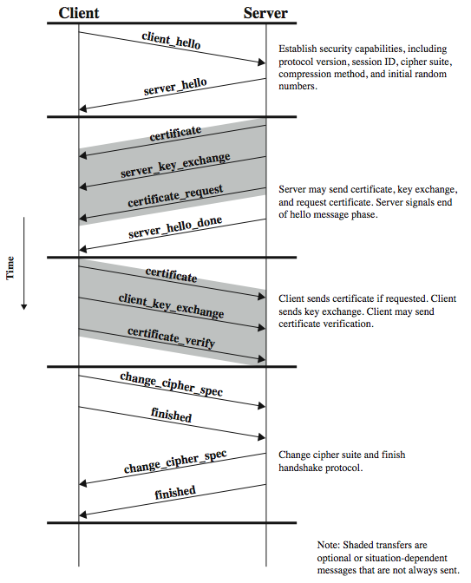
Handshake Protocol
Notes:
The Handshake Protocol consists of a series of messages exchanged by client and server. Stallings Figure 6.18 shows the initial exchange needed to establish a logical connection between client and server. The exchange can be viewed as having four phases. The first phase is used to initiate a logical connection and to establish the security capabilities that will be associated with it, and is initiated by the client. The second phase is used for server authentication and key exchange. The server begins this phase. The third phase is used for client authentication and key exchange. If all is satisfactory with the info from the server, the client sends one or more messages back to the server. The fourth phase completes the setting up of a secure connection. At this point the handshake is complete and the client and server may begin to exchange application layer data.

Slide 39
WTLS Authentication
WTLS authentication
uses certificates, making use of X.509v3, or WTLS certificates, which consists of:
Certificate version
Signature_algorithm
Issuer
Valid_not_after
Subject
Public_key_type
Parameter_specifier
Public key
Signature
can occur between client and server, or client may only authenticates server – WTLS defines that authentication is an optional procedure
Notes:
Authentication in the WTLS is carried out with certificates. Authentication can occur between the client and the server or the client only authenticates the server. The latter procedure can happen only if the server allows it to occur. The server can require the client to authenticate itself to the server. However, the WTLS specification defines that authentication is an optional procedure. Currently, X.509v3, X9.68 and WTLS certificates are supported. The WTLS certificate is optimized for size.
The purpose of the WTLS protocol is for the client and server to generate a mutually shared pre-master key. This key is then used to generate as master key. A number of key exchange protocols are supported by WTLS. They can be grouped into those protocols that include a server_key_exchange message as part of the handshake protocol (see Figure 17.18 on previous slide) and those that don't. The server_key_exchange message is sent by the server only when the server certificate message (if sent) does not contain enough data to allow the client to exchange a pre-master secret, including for conventional Diffie-Hellman performed anonymously, elliptic curve Diffie-Hellman, or RSA key exchange without authentication. The server key exchange message is not sent for Elliptic curve Diffie-Hellman key exchange with ECDSA-based certificate, or for RSA key exchange with RSA based certificates.

Slide 40
WTLS Key Exchange
It generates a mutually shared pre-master key
It can used the following:
conventional D-H scheme
Elliptic curve D-H computation
RSA key exchange
Notes:
Authentication in the WTLS is carried out with certificates. Authentication can occur between the client and the server or the client only authenticates the server. The latter procedure can happen only if the server allows it to occur. The server can require the client to authenticate itself to the server. However, the WTLS specification defines that authentication is an optional procedure. Currently, X.509v3, X9.68 and WTLS certificates are supported. The WTLS certificate is optimized for size.
The purpose of the WTLS protocol is for the client and server to generate a mutually shared pre-master key. This key is then used to generate as master key. A number of key exchange protocols are supported by WTLS. They can be grouped into those protocols that include a server_key_exchange message as part of the handshake protocol (see Figure 17.18 on previous slide) and those that don't. The server_key_exchange message is sent by the server only when the server certificate message (if sent) does not contain enough data to allow the client to exchange a pre-master secret, including for conventional Diffie-Hellman performed anonymously, elliptic curve Diffie-Hellman, or RSA key exchange without authentication. The server key exchange message is not sent for Elliptic curve Diffie-Hellman key exchange with ECDSA-based certificate, or for RSA key exchange with RSA based certificates.

Slide 41
WTLS Encryption Algorithm
The encryption keys will be generated from the master key
Encryption algorithms
Algorithm | Key Size (bits)
RC5 | 40, 56, 64, 128
DES | 192
3DES | 40
IDEA | 40, 56
Notes:
The WTLS Pseudorandom Function (PRF) is used for a number of purposes. The PRF takes as input a secret value, a seed, and an identifying label, and produces an output of arbitrary length. WTLS PRF is implemented using only one hash algorithm (unlike TLS). Which hash algorithm is actually used, is agreed during the handshake as a part of the cipher spec. The PRF is based on a HMAC based data expansion function. See text for details.
Master Key Generation of the shared master secret, a one-time 20-byte value (160 bits) generated for this session by means of secure key exchange. First, a pre_master_secret is exchanged. Second, the master_secret is calculated by both parties, using the following function:
master_secret = PRF( pre_master_secret, "master secret",
ClientHello.random || ServerHello.random )
where the random numbers are exchanged during the first phase of the handshake protocol. The MAC and encryption keys are then derived from the master key, using the HMAC algorithm, and encompasses these fields:
HMAC_hash ( MAC_secret, seq_number || WTLSCompressed.record_type
|| WTLSCompressed.length || WTLSCompressed.fragment )
Either MD5 or SHA-1 may be used for the HMAC hash function.
Encryption is applied to all of the WTLS record, except the header, using RC5, DES, 3DES, or IDEA encryption algorithms.

Slide 42
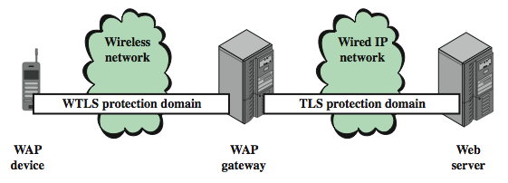
WAP End-to-End Security
There is a security gap end-to-end
at gateway between WTLS & TLS domains
Notes:
The basic WAP transmission model, involving a WAP client, a WAP gateway, and a Web server, results in a security gap, as illustrated in Stallings Figure 17.19. The mobile device establishes a secure WTLS session with the WAP gateway. The WAP gateway, in turn, establishes a secure SSL or TLS session with the Web server. Within the gateway, data are not encrypted during the translation process. The gateway is thus a point at which the data may be compromised.
There are a number of approaches to providing end-to-end security between the mobile client and the Web server. In the WAP version 2 (known as WAP2) architecture document, the WAP forum defines several protocol arrangements that allow for end-to-end security. Version 1 of WAP assumed a simplified set of protocols over the wireless network and assumed that the wireless network did not support IP. WAP2 provides the option for the mobile device to implement full TCP/IP-based protocols and operate over an IP-capable wireless network.

Slide 43
Summary
In this lecture, we have studied
Wireless technologies
IEEE 802.11 Wireless LAN security
802.11i Robust Security Network
802.11i Phases of Operation
Wireless Transport Layer Security (WTLS)
WAP End-to-End Security
Notes:
Chapter 6 summary.

Slide 44

Questions?

